Slide 1
Knapsack and Variations
Alex Li

Slide 2
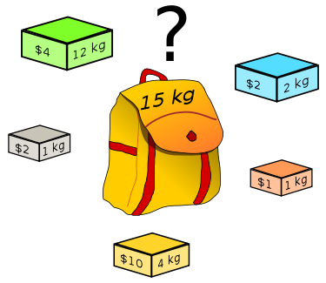
The knapsack problem
You want to put some items of varying weights and values into a bag which can carry a maximum weight. You want to maximize the value

Slide 3
0-1 knapsack
If you have N items, there are 2^N total possibilities, so the brute force algorithm is O(N2^N) or O(2^N).

Slide 4
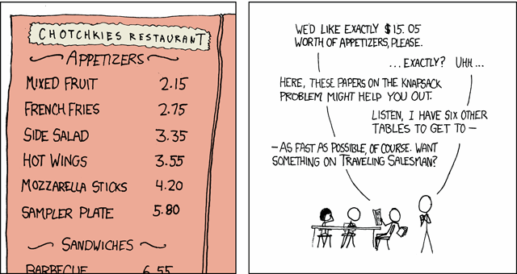

Can we do better?
The (decision version) of the knapsack problem is NP-complete, so probably not.

Slide 5
Can we do better?
What happens as we add an item of value 4 and weight 12?
bestScoreForFixedWeight[w] = max(bestScoreForFixedWeight[w], bestScoreForFixedWeight[w-12] + 4)

Slide 6
Pseudocode
dp[0] = 0, dp[1..item_weight] = -inf
for (item_value, item_weight) in item_list:
for w in [item_weight, item_weight + 1, … , max_weight - 1, max_weight]:
dp[w] = max(dp[w], dp[w - item_weight] + item_value)
print(dp(max_weight))
Consider 1 item with value 1, weight 2
Notes:
Extra: can we change the order of the loops?

Slide 7
Pseudocode 2.0
dp[0] = 0, dp[1..item_weight] = -inf
for (item_value, item_weight) in item_list:
for w in [max_weight, max_weight - 1, … , item_weight + 1, item_weight]:
dp[w] = max(dp[w], dp[w - item_weight] + item_value)
print(max of dp[i] over all i)
Speed?
O(|item_list|*max_weight)
Notes:
You can also ada

Slide 8
Wait… Isn’t that polynomial time?
The time to solve the problem is still exponential in the length of the input - imagine if max_weight was a 10000 digit long number.

Slide 9

Unbounded knapsack
Now, we have infinitely many of each item. Can we still do this quickly?
The ‘wrong’ solution works if we fix the last line

Slide 10
Wrong solution (reminder)
dp[0] = 0, dp[1..item_weight] = -inf
for (item_value, item_weight) in item_list:
for w in [item_weight, item_weight + 1, … , max_weight - 1, max_weight]:
dp[w] = max(dp[w], dp[w - item_weight] + item_value)
print(dp(max_weight))
Notes:
Extra: can we change the order of the loops?

Slide 11

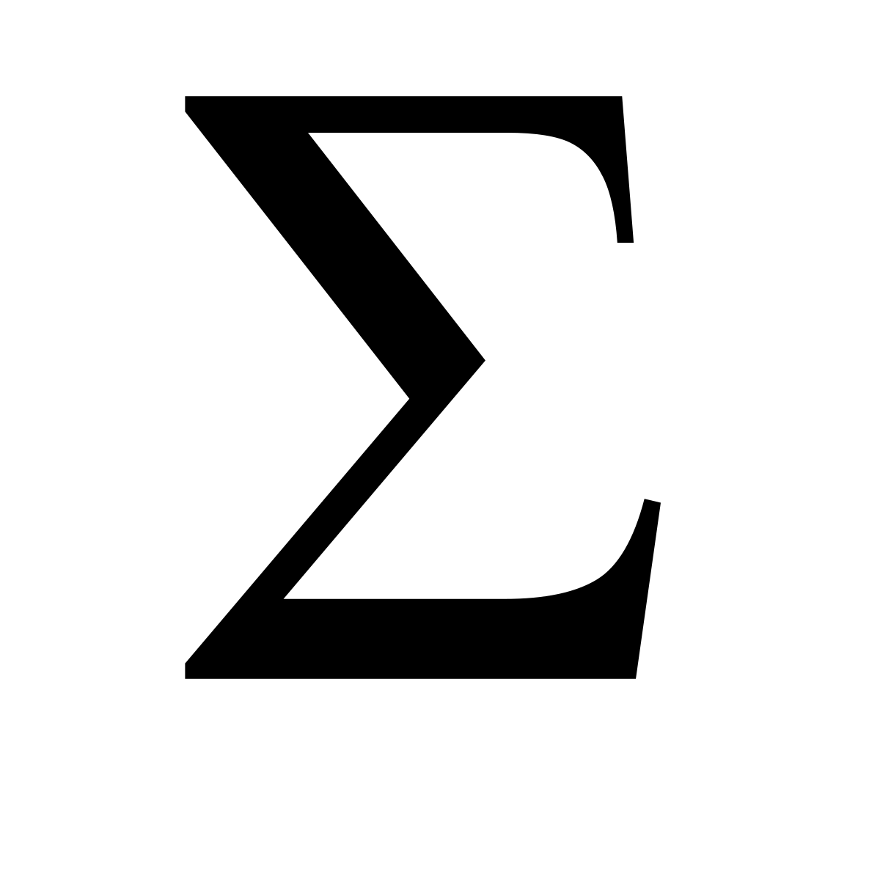
Subset Sum
Given a set of numbers, is there a subset that sums to a specific value?
Set the values to equal to 0.
Only check the last element like in the ‘wrong’ solution
Notes:
Note this is the xkcd comic
So, what could the ‘wrong’ solution be solving?

Slide 12
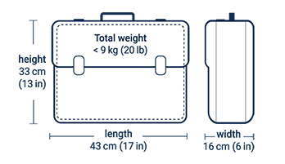
Multi-value knapsack
What if each item has several costs, say a weight and a size?
for (item_weight, item_size, item_value) in item_list:
dp[w][s] = max(dp[w][s], dp[w - item_weight][s- item_size] + item_value)
Notes:
Iteration order depends on if you are doing 0-1 or unbounded knapsack

Slide 13
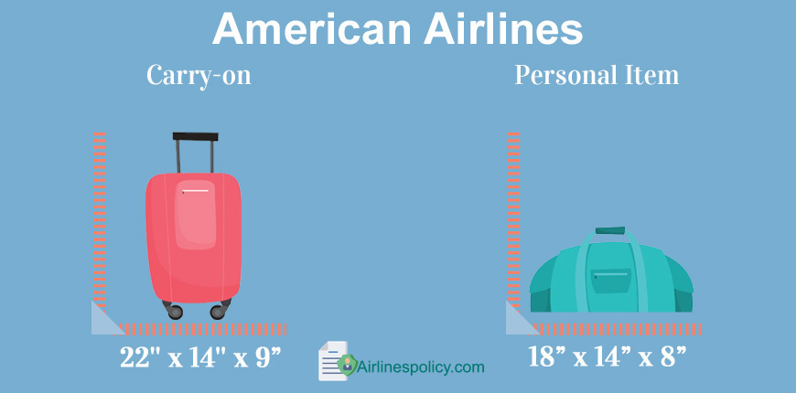
Multiple Knapsack
Easy for unbounded number of each item.
What if you have 2 knapsacks?
For 0-1 knapsack:
DP[w1][w2] = max(DP[w1][w2],
item_value + DP[w1 - item_weight][w2],
item_value + DP[w1][w2 -item_weight])

Slide 14

Questions

Slide 15
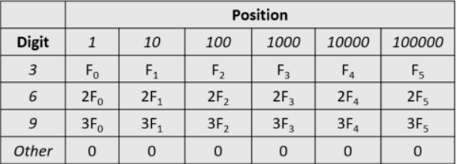
Lucky Numbers
https://codeforces.com/contest/1428/problem/G1
The digits 3, 6, and 9 are lucky, and we like numbers with those digits.
The luckiness of the number 3916 is F₃ + 3F₂ + 0 + 2F₀

Slide 16
Lucky Numbers
Think about it!
The luckiness of a list of numbers is the sum of the luckiness of each number.
Find luckiness of the most lucky list of 0<k<10^6 nonnegative numbers that sum to 1<n<10^6.
If n=30, k=2, F₀=1, F₁=10, the most lucky list is [9, 21] for an answer of 3

Slide 17
Lucky Numbers - Commonness of 3, 6, and 9
Proof: If two digits in the same place aren’t the same and aren’t multiples of 3, make one bigger and the other smaller so that one becomes a multiple of 3.
(43, 46) -> (33, 56) is better
(114, 423) -> (201, 336) is better
(91, 92, 94, 95) -> (90, 93, 90, 99) is better
Observation 1. At most 1 of the k numbers has a digit that isn’t 3, 6, or 9.

Slide 18
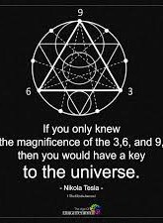
Lucky Numbers - Reducing to 3, 6, 9 case
Try every possibility for the number that isn’t a multiple of 3.

Slide 19
Lucky Numbers - 3 Independence Observation
Observation 3. There are at most 3*k ‘3’s in the ones/tens/… place, independent of the other positions
Observation 2. We can treat a 6 as 2 3’s and a 9 as 3 3’s.

Slide 20
Lucky Numbers - Knapsack Observation
Observation 4. Supposing that we only have 3’s, 6’s, and 9’s, we are trying to fill a knapsack with capacity n.
We have 3*(k-1) values with weight 3 and value F₀
We have 3*(k-1) values with weight 30 and value F₁
…
We have 3*(k-1) values with weight 300000 and value F₅
We want to put them all into our bag with capacity N.

Slide 21

Lucky Numbers - Summary so far
In total, we have 18*(k-1) items to put into a bag of capacity N.
O(items*capacity)
= O(18*(k-1)*n)
= O(kn)
Speed?

Slide 22
Lucky Numbers - Compactifying identical items
Observation 5: We can represent a list of the same item several times in a much more compact form.
(1, 1, … , 1, 1) as a sum of elements of (1, 2, 4, 8, 10)
(for any 25)
(25 ones)
O(items*capacity)
= O(log(18*(k-1))*n)
= O(log(k)n)
Speed?

Slide 23
Lucky Numbers
Code solution
https://codeforces.com/contest/1428/submission/96330273

Slide 24
Challenge problem
https://codeforces.com/contest/19/problem/B

